Slide 1


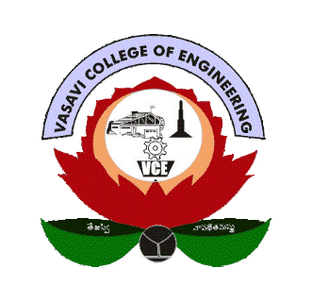
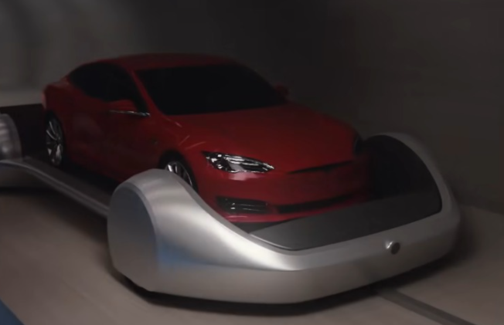
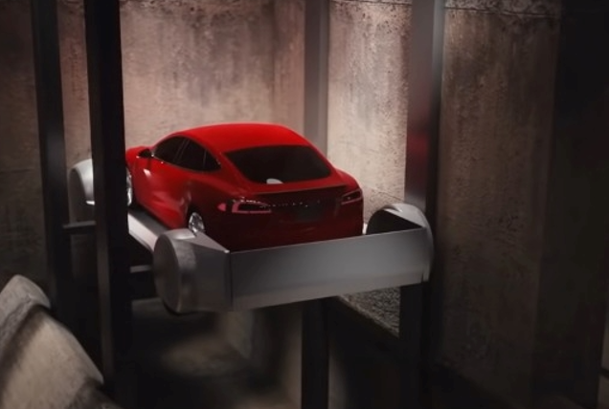
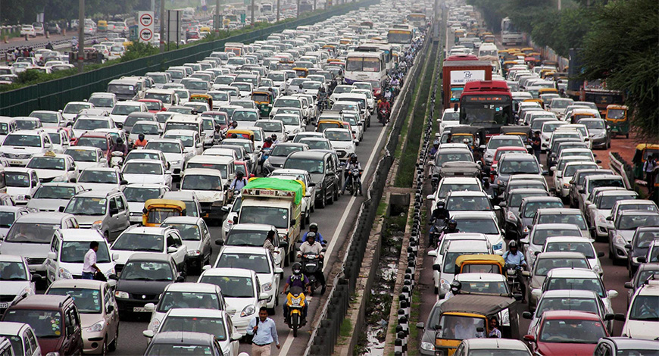
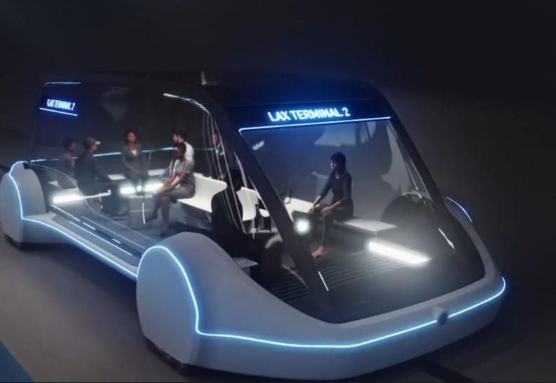
Logo of your institution
goes here
An Outlook For Traffic Congestion Using Tunneling Technology
P. Ashishª, K. Gopi krishna^{b}, Dr. V. Sireesha^{c} , Dr. Nagarathna P Hegde^{d}
^{A,b,*c,d} Vasavi College of Engineering (A) , Hyderabad, Telangana, India
* Email: v.sireesha@staff.vce.ac.in
Concept of Tunneling technology
Inescapable Truth of Urban Life
There will be trays which carries them through tunnels. The user who ever feels the road traffic is heavy can enter the tray which carries the user into the tunnels. These tunnels are paths connected from one city to other internally. So, the user chooses his/her source and destination and enter the tray. Within stipulated limit of time the user reaches his destination
Generally, we see a lot of traffic during these days. Traffic congestion has been one of the major issues that most metropolises are facing despite measures being taken to mitigate and reduce it. There have been attempts to develop congestion measurement indices for heavily motorized countries. In this regard, our project aims to develop a prototype to alleviate traffic congestion and enable rapid transit across densely populated areas.
Car in a Tray
Traffic Congestion
References
A case study on Tunnel traffic analysis by simulation at the peak traffic time of vehicles, Amir Abbas Shojaie, Issue: 2016.
Basic Traffic Engineering Concepts, Zainab Ahmed Alkaissi, Al-Mustansiriya University, Baghdad, Iraq. Issue published:2020
People traveling in a Tray
First International Conference on Technologies for Smart Green Connected Society 2021
29th-30th November 2021 | Online | World Wide | 100+ Global Academic Partnerships & Alliances

